Slide 1
Introduction to Survival Analysis Part #2
Dr Oliver Perra
Full resource, see: https://www.ncrm.ac.uk/resources/online/all/?id=20850

Slide 2
So far…
Survival Analysis: statistical method to answer questions concerning:
Whether and When an event takes place
Prerequisites:
#1 Define event occurrence: transitions between states
#2 Identify “beginning of time”: starting point of study should not be related to the target event occurrence
#3 Specify time metric: smallest possible unit relevant to the event of interest

Slide 3
Outline
Censoring and its challenges
Life Tables for Discrete Time Event Occurrence
Hazard Function
Survivor Function
Notes:
In this presentation I will first talk about censoring and why this is key challenge in survival analysis
I will then introduce a way to summarise survival statistics using life tables.
This will allow me to introduce the hazard function and survivor function.
I highlight that in this and the next presentation I will only present examples of discrete time events, events that are measured in coarse time units like years.
I do this because in my experience it is the best way of understanding the concepts and principles of survival analysis. Once these concepts are developed, I found it easier to understand the more sophisticated methods that are used to describe and analyse continuous time event occurrence, like the Kaplan-Meier method and Cox regression models.
Overall, I think that considering first the basics of discrete time event occurrence help lay out a strong foundation for understanding survival analysis.

Slide 4
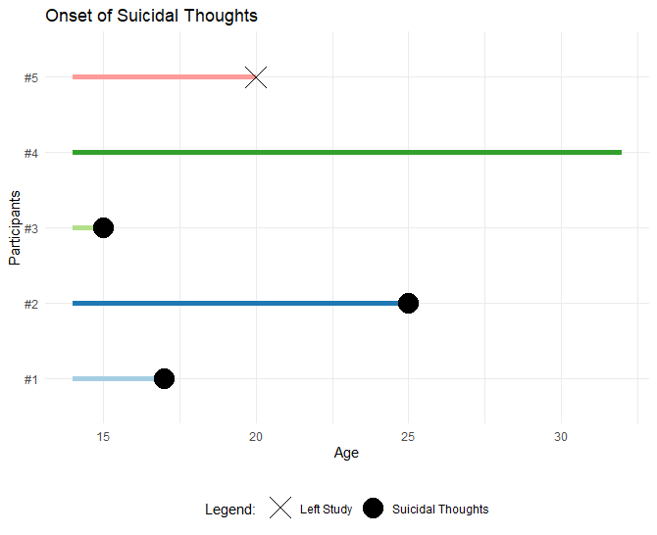
A key challenge…Censoring
Some participants never experience the event (#4) during the study
Some leave the study before we can record the event (#5)
Notes:
Survival analysis provides a solution to a key challenge when analysing data on event occurrence.
In the first presentation I provided this fictional example. We are interested in investigating whether and when young persons first experience suicidal thoughts.
Assume that we ran this study recruiting adolescents at 14 years of age and followed them up until age 32.
As it happens, participant 5 dropped out from the study before reporting the target event, and participant 4 finished the study but never reported the event taking place. We do not know the timing of the event of these participants, and when we don’t know this, we talk about “censoring”.
This examples illustrates the reasons why censoring happens: either participants never experience the event during the study, as participants #4, or some participants leave the study before we can record the event, like participant #5.
There may be studies where there is no censoring: for example, if we are investigating life expectations of a group of individuals, provided that we study them long enough until they eventually pass away and no one drops out from the study, then we will not have censored data. But censoring is usually present in studies of event occurrence.

Slide 5
A key challenge…Censoring
Non-informative:
Independent of event occurrence. E.g.: by design → end of the study
Informative:
Participants with censored data are likely to have experienced the event
Notes:
The problem with censoring is then the problem of missing data. In some instances we can be confident that censoring is not linked to the target event occurrence. In these cases we say that censoring is non-informative: it is independent of the target event. For example, participant #4 here is censored by design since we finished the study at that point. The decision to end the study at age 32 is independent of the event we are interested in.
Take participant #5 however: if the participant left the study independently from the target event, we would also say that in their case censoring was non-informative. For example, the participant may have left the study because they emigrated. In similar cases, if we are confident that censoring was non-informative and can assume that all participants that remain in the study after censoring are representative of participants who would have remained in the study had censoring not occurred.
But if we didn’t know why participant #5 is censored we may worry that the reasons that led to the participant being censored were linked to the target event: if the participant left the study because suicidal thoughts occurred and were so severe that the participant acted on these thoughts, than leaving the study is directly linked with the event occurrence that we did not record. In this case, we say the censoring is informative.
In the latter case we cannot assume that participants that remain in the study after censoring are representative of all individuals who would have remained in the study had censoring not happened.
Similarly to other methods that deal with missing data, survival analyses inferences are valid if we can reasonably assume that the mechanisms of censoring are non-informative: either censoring happens at random, for example participants emigrate, or censoring is by design, e.g. researchers terminate the study at a certain point.

Slide 6
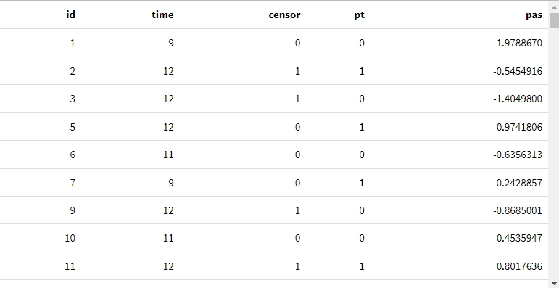
Dataset
Capaldi et al. (1996): Predicting the Timing of First Sexual Intercourse for At-Risk Adolescent Males. NOTE: modified dataset
N = 180
Beginning of time: Grade year 7; Time metric: Grade years 7 to 12 (discrete);
Target Event: Yearly Self-reported initiation of intercourse;
Covariates: Parental Transitions (pt); Parental Antisocial Scores (pas)
Notes:
In the remainder of this and the next presentation I will use a dataset to illustrate the methods.
This dataset comes from a study published in 1996 in Child Development. Male heterosexual adolescents were followed up from grade year 7 to grade year 12, roughly 12 to 13 years to 17/18 years of age.
The beginning of time was grade 7, the target event was initation of sexual intercourse, in what year did adolscents reported they had started having sexual relationships. There were also some covariates, which I will describe in the next presentation.
I have modified this dataset to introduce some non-informative censoring, I have censored some data at random. The dataset and the R script to run the examples are available with the course material.

Slide 7
Dataset
Capaldi et al. (1996): Predicting the Timing of First Sexual Intercourse for At-Risk Adolescent Males. NOTE: I have modified the dataset
Beginning of time: Grade year 7; Time metric: Grade years 7 to 12;
Target Event: Yearly Self-reported initiation of intercourse;
Covariates: Parental Transitions (pt); Parental Antisocial Scores (pas)
Notes:
I wanted to draw the attention to the structure of the data here. There isn’t a variable that reports whether the event took place or not: we can infer it by looking at the combination of the “time” and “censor” variable. Since the case is not censored, the event took place.

Slide 8
Dataset
Capaldi et al. (1996): Predicting the Timing of First Sexual Intercourse for At-Risk Adolescent Males. NOTE: I have modified the dataset
Beginning of time: Grade year 7; Time metric: Grade years 7 to 12;
Target Event: Yearly Self-reported initiation of intercourse;
Covariates: Parental Transitions (pt); Parental Antisocial Scores (pas)
Notes:
If we look at ID #2, we can see the case is censored, so the case left the study without the event ever taking place.
In this study the researchers stopped following up participants after grade 12, so the censoring is not informative, not related to the event taking place.

Slide 9
The Life Table
Rows: time intervals including initial time and excluding concluding time.
n.risk: Risk Set, number at risk in each interval
Not censored, still in the study &
Not yet experienced the target event
i.e., are at risk of experiencing the event
Notes:
The life table provide summary information regarding the event occurrence over time.
In the rows we have time intervals, grade 7 to 8, grade 8 to 9, etc. The interval includes the initial time, i.e. the start of year 7, but excludes the concluding time, i.e. the start of year 8.
The n.risk column reports the numbers of participants that were in the study and had not yet experienced the target event at the beginning of the interval. At the beginning of interval 7, the “beginning of time” all participants had not yet had intercourse by design. N.risk means that this is the number of participants at risk of experiencing the event for the first time.
The n.event reports the number of participants who experienced the event during that interval, e.g., 15 had reported sexual intercourse for the first time between grade 7 and grade 8.
The n.cesor is the number censored, those who left the study before the target event was ever recorded.
Note that the number at risk in every interval is the number of participants in the study minus the sum of those that had experienced the event in the previous interval and those censored in the previous interval. For example, the risk set in year 10 is 158 – (18 +6) = 134

Slide 10
Discrete Time Hazard Function:
Conditional probability that participant will experience the event in the given interval, provided the participant did not experience it in any previous time period.
$${h(t}_{ij})=\operatorname{Pr}\left[ T_{i}=j\right|T_{i}≥j]$$
Where:
$$i →participant in study;$$
$$j→time period in study;$$
$$T_{i}→ time period j$$
$$where individual i$$
$experiences target event$;
Notes:
The hazard reported here is the hazard function. This is defined as the conditional probability that an individual will experience the event in a specific time interval, provided the participant did not experience the event in previous time interval.
Here I have reported the formal definition of the hazard function, h(tij). i indicates an individual in the study, j a time period, Ti the time period j when individual i experiences the target event. The hazard function for individual i in interval j is the probability that the event will occur in the current time period, given that it must occur now or sometime in the future. In a way this is specifying the converse of the definition, since the target event has not yet occurred, the formula expresses the probability of the event in the current time interval, provided it should occur in the current or future time intervals.
The point is that he hazard function tells us whether and when the target event is more likely to take place.
Since this probability is conditional on the participant not experiencing the event before the time interval of interest, the hazard function represents the probability of event occurrence among those that are eligible to experience the event in that interval, that is, excluding those that had already experienced it or have left the study. This consideration emphasises the importance of non-informative censoring: to be able to have informative probabilities we must be able to assume that those 134 that enter the study in year 10 are representative of the all cases that would have entered the study in year 10 had there not been censoring.

Slide 11
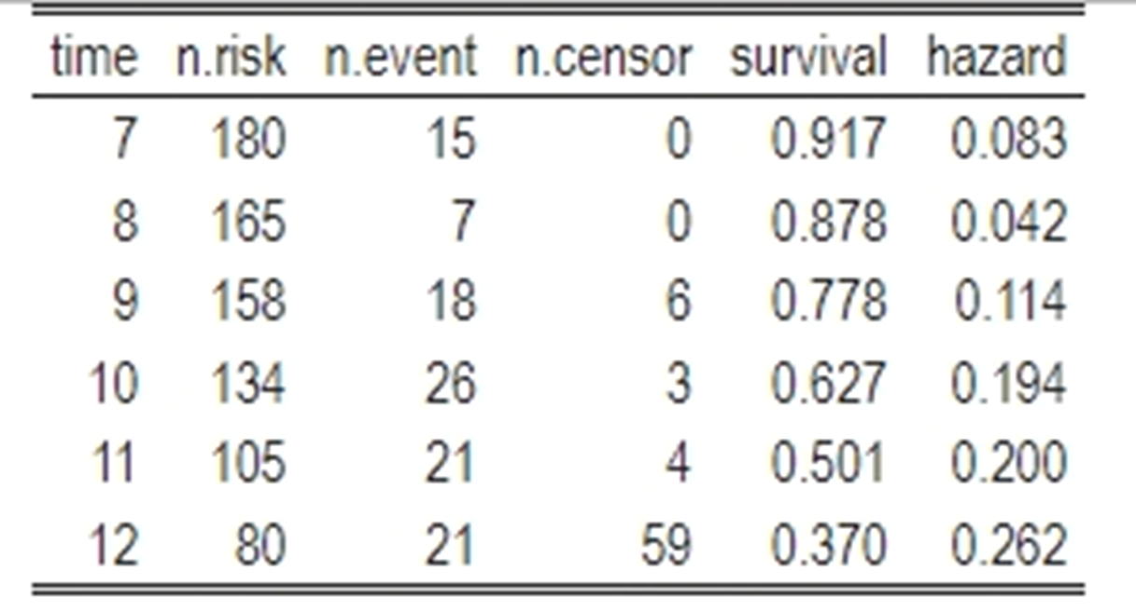
Discrete-time Hazard Function:
Conditional probability that individual will experience the event in the given interval, provided the participant did not experience it in any previous time period.
For j intervals:
$\frac{{n event}_{j}}{{n at risk}_{j}}$ = $\frac{18}{158}= .114$
Notes:
To understand how the hazard function is calculated, let’s consider a time interval.
In year 9 for example the risk set is n=158, and 18 participant experienced the event for the first time. So the probability of the event taking place in this interval is 18/158 = .114.
It’s important to note that these proportions are maximum likelihood estimates of the discrete time hazard function, and are the discrete limits of the Kaplan-Meier hazard estimates for continuous time, which you will encounter when you engage with survival analysis beyond this introductory presentation.

Slide 12
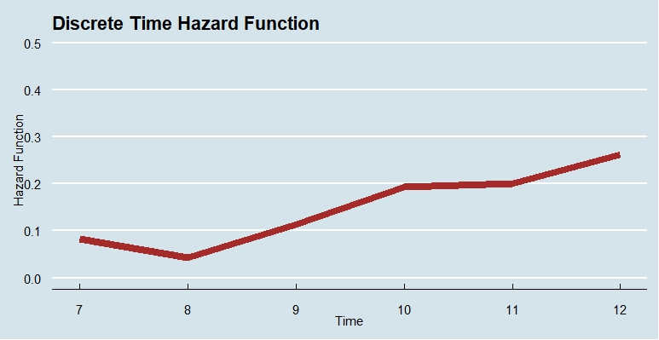
Discrete-time Hazard Function:
For j intervals:
$\frac{{n event}_{j}}{{n at risk}_{j}}$
Notes:
Let’s plot the hazard function as a line that links the estimates for different time periods. Since hazard is a probability, it will vary between 0 and 1. In this example, we can see that the probability of initiating sexual intercourse among male adolescents in the study was low in the first two years, but increased and was higher in year 12.

Slide 13
Survivor Function
Probability of “surviving” past a time interval j for a randomly selected individual i.
For j intervals:
$\frac{{n who have not yet experienced event within interval}_{ j}}{n}$ = $\frac{158}{180}= .878$
Notes:
Overall, the hazard function estimates the unique risk of the event within an interval.
The survivor function instead cumulates the estimate of risk over time periods to estimate the probability that a randomly selected individual will survive, i.e. will not experience the target event in that time interval.
While at the start of the study all participants are survivors by definition, they have not yet experienced the event, by the end of the first year the probability of surviving is approximately 92%, and by the end of year 8 is 88%. Since this a cumulative estimate, the probability of surviving will never increase over time.
To understand how it is calculated, let’s consider the first two intervals where there is no censoring.
Generally, the formula consider those who have not yet experienced the target event within a certain interval, divided by the number of participants.
At the end of year 8, 158 participants had not yet experienced sexual intercourse, in fact they are in the risk set at the beginning of year 9. We divid 158 by 180 participants in the sample, and this tells us that the probability of surviving, not initiating sexual intercourse in year 8 is approximately 88%.

Slide 14
Survivor Function
Probability of “surviving” past a time interval j for a randomly selected individual i.
For j intervals:
$\frac{{n who have not yet experienced event within interval}_{ j}}{n}$ = $\frac{???}{180}= ???$
Notes:
However, when we have censoring, we do not know how may adolescents did not experience the target event by the end of the time intervals.
We can get around this problem considering that the hazard function tell us about the probability of event occurrence within a time interval, so, conversely, also tells us about the probability of the event not taking place.
Therefore, the survivor function can be calculated based on the hazard function.

Slide 15
Survivor Function
Probability of “surviving” past a time interval j for a randomly selected individual i.
$1 − .083= 0.917$
For j intervals:
$\frac{{n who have not yet experienced event within interval}_{ j}}{n}$
Notes:
For example, if in the first interval the probability of experiencing the event is .083, we subtract this from 1, and we obtain the probability of surviving during the first time interval.

Slide 16
Survivor Function
Probability of “surviving” past a time interval j for a randomly selected individual i.
(1- .042) survive in the year.
But only .917 from original sample are still at risk.
Therefore:
(1- .042) * .917 = .878
$${\hat{S}(t}_{j})={\hat{S}(t}_{j−1}) [1−{\hat{h}(t}_{j})]$$
Where:
$$i →participant in study;$$
$$j→time period in study;$$
${\hat{h}(t}_{j})$ $→estimated hazard in time period j$
The same logic applies to periods where there is censoring
Notes:
In year 8, the hazard function is .042. So we can subtract this from one to learn the probability of the event not taking place. But we then need to consider that only .917 of the original sample were at risk at the start of year 8, so to estimate the cumulative probability of surviving past year 8, we need to multiply the probability of event non-occurrence by the proportion of participants still at risk, so …
The same logic applies when there is censoring. For example, the survivor function in year 12 is (1-.262)*.501.
I also include the formal expression of this survivor function, which indicates the survivor function for interval j is the product of the survivor function in the previous interval j-1 and (1 - the estimated hazard function for period j).

Slide 17
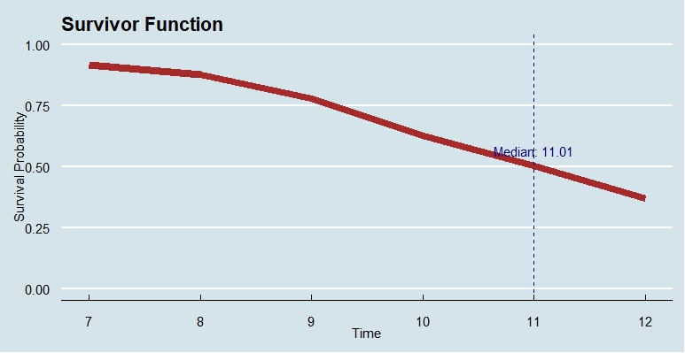
Median Lifetime
Survivor Function:
Probability of “surviving” past a time interval j for a randomly selected individual i.
Median Lifetime:
Time point where the value of the estimated survivor function is .50
Median Lifetime
Notes:
Finally, the survivor function is useful in providing an estimate of central tendency, the median lifetime.
If there were no censoring, we can calculate the mean age of event occurrence. But as I showed, this is not straightforward when we have censoring.
The median lifetime is the time value where the estimated survivor function is .50, or, in other words, the point where half of the sample has experienced the target event.
In cases where the time measure is discrete, as it is here, the method used to estimate the median lifetime is interpolation, and you can find details in references and the supporting material for this resource.
Here the median lifetime is 11.01: by the start of 11.01, (16 / 17 years) half of the adolescents in the sample will have initiated sexual intercourse, while half of them have not yet.

Slide 18
Hazard and Survivor functions together provide insights
Notes:
Finally, both functions together are useful in providing insights into the phenomena. As I discussed, the two functions are linked. This link can be seen by noting that in the first two grades the hazard function is low, and in the same years the survivor function remains relatively shallow. After year 8, the hazard function increases, and we note a relatively steeper decline in the survivor function.
It is useful to use the two graphs in combination, particularly because hazard functions can vary a lot more across time and it may be difficult to recognise a pattern.

Slide 19
Summary
Censoring: analyses assume non-informative mechanisms
Life Tables summarise event occurrence over time
Hazard function: conditional probability of individual experiencing the event in the interval, given they did not experience it before
Survivor function: probability of surviving past a time interval for a randomly selected individual

Slide 20
www.ncrm.ac.uk

